Slide 1

Review-BD.net : A website to share user experiences on different products and services
Supervised by
Dr. Mohammad Rezwanul Huq
Assistant Professor
Department of Computer
Science & Engineering
East West University
By
Md. Zahidul Islam
2011-1-60-018
Mamun Hosen
2011-1-60-035

Slide 2
Overview
Introduction
Motivation
Tools Support
System Design
Future Aspects
Conclusion

Slide 3
Introduction
Experience Sharing
A Big Platform for Bangladeshi Products and services
Mobile Responsive

Slide 4
Motivation
Fewer websites to share experiences
For Bangladeshi products and services
All in one

Slide 5
Tools Support
XAMPP (Version-1.8.2)
Customize Bootstrap (Version-3)
PHP (Codeigniter Framework)
JavaScript/jQuery
Sublime Text (Version 2.0.2)

Slide 6
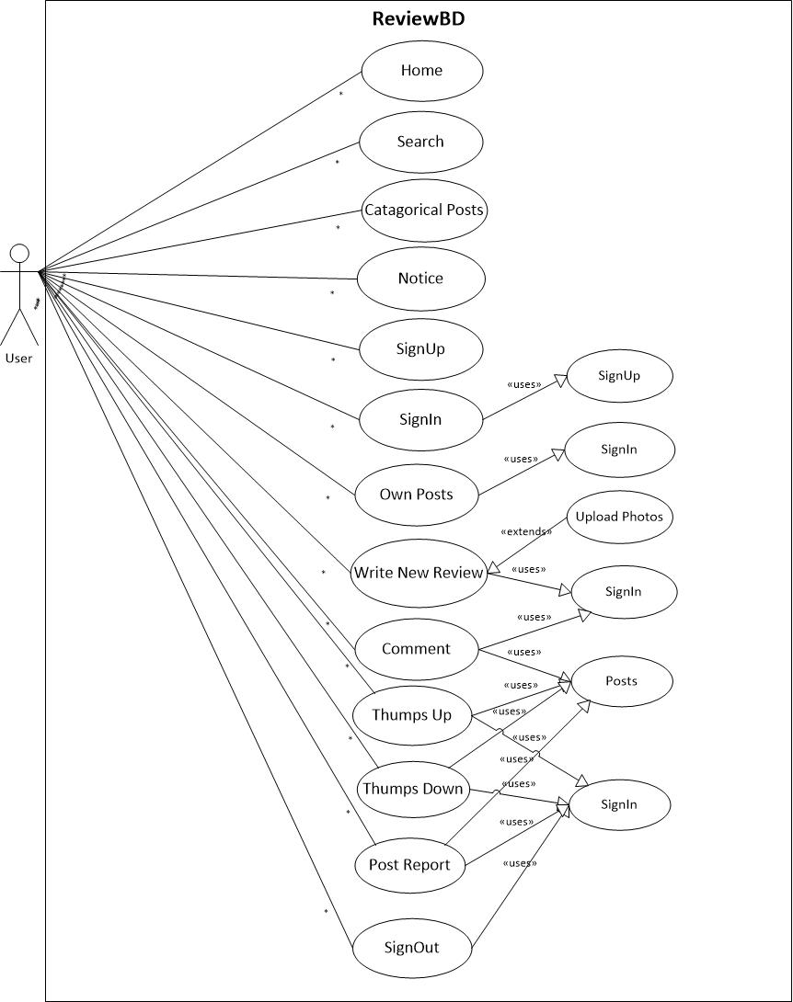
System Design (Use case Diagram- ReviewBD)

Slide 7
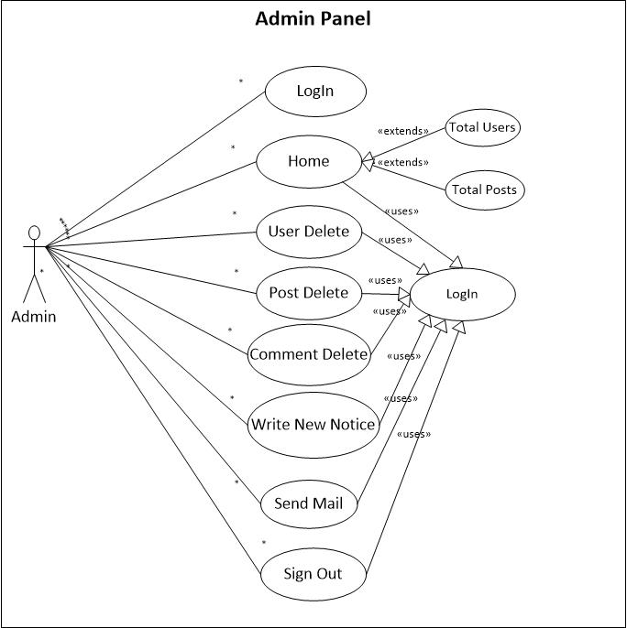
System Design (Use case Diagram- Admin Panel)

Slide 8
Future Aspects
More Categories
Ajax Based Comment and Rating System
Notification System for Users
Generate useful business intelligence

Slide 9
Conclusion
Word of Mouth
Better User Experience

Slide 10
Thank You

